Slide 1

Project-2
Project Topic: World Happiness 2019
Group Members
Jasjeet Kaur
Saleha Khatun
Erika Hoshino
Phimnarin Aksupak

Slide 2
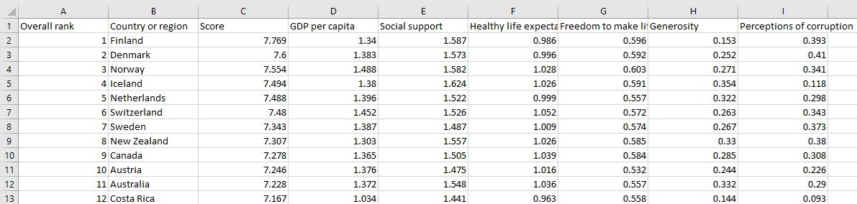
Dataset
- Contains happiness rankings and factors affecting these rankings for 156 countries
- This dataset informs policies in areas like well being, health and finance
Factors affecting happiness

Slide 3
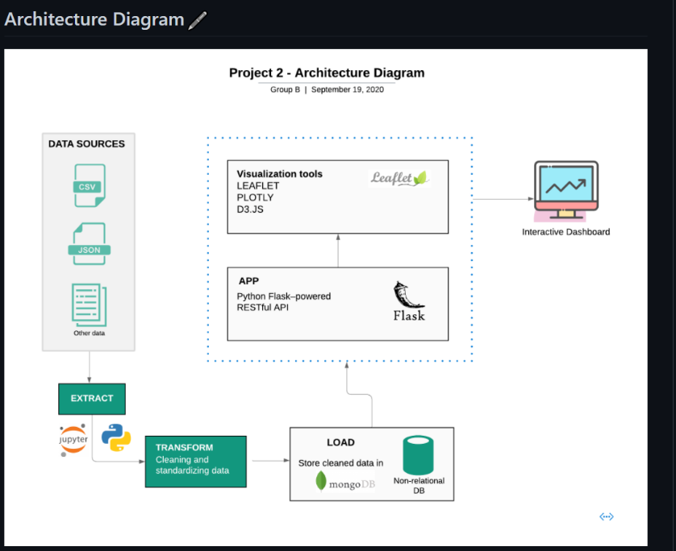
Our Approach
Clean data Load in PostgresSQL database

Slide 4
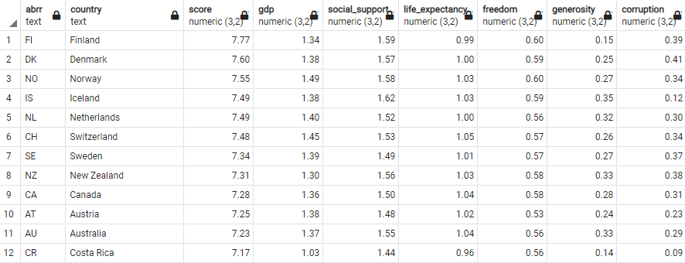
Data stored in PostgresSQL

Slide 5
Python Flask-Powered API
1. Import dependencies
import numpy as np
import pandas as pd
from sqlalchemy import create_engine, func
from flask import Flask, jsonify, render_template
2. Fetch the data from the database
results = engine.execute("SELECT * FROM data").fetchall()
3. Flask Routes
To make data accessible
@app.route("/data")
def Happiness_dataset():
data = pd.read_sql_query('select * from data', con=engine)
return jsonify(data.to_json(orient="records"))
To display interactive dashboard
@app.route("/")
def index():
return render_template("index.html")

Slide 6
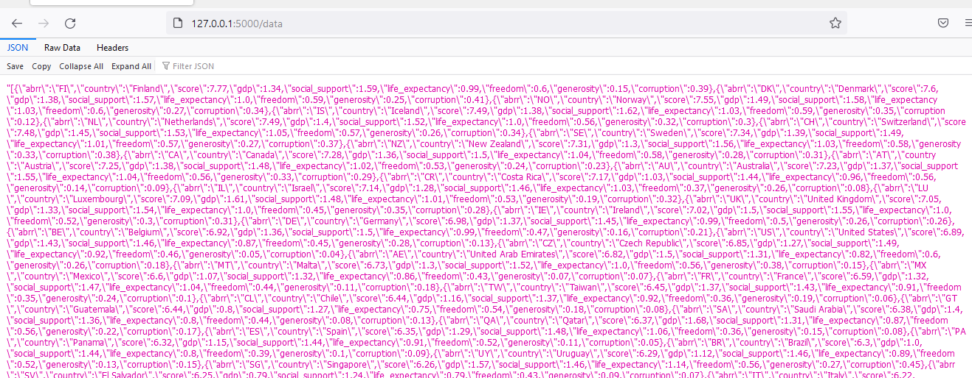
Data accessibility from the server

Slide 7
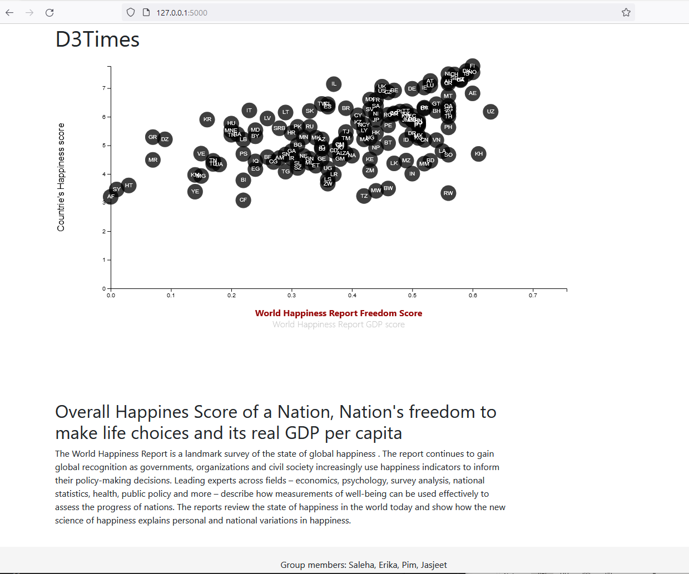
Display of interactive Visualization through server

Slide 8
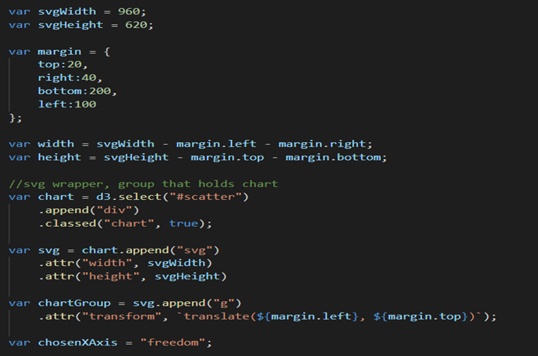
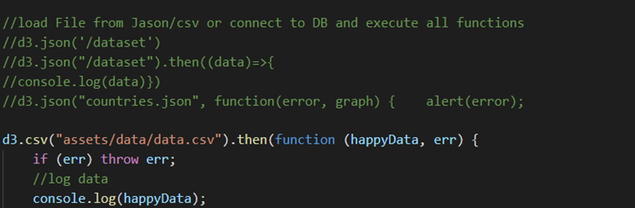
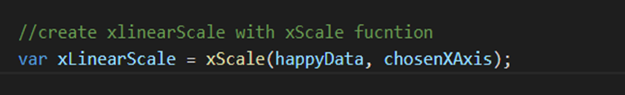
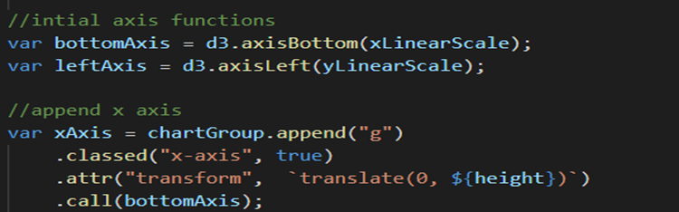
D3-Visualization
Countries happiness Score With World Happiness Report GDP score
& World Happiness Report Freedom Score
Requests / Selections/ Scales/ Axes
Load
Scales
Axis function

Slide 9
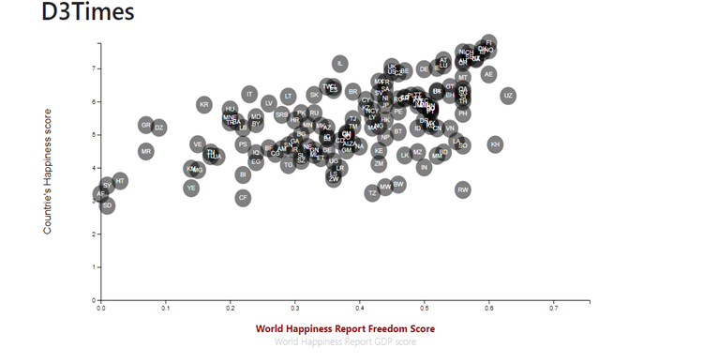
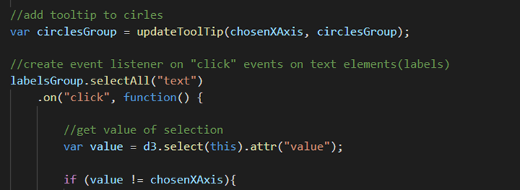
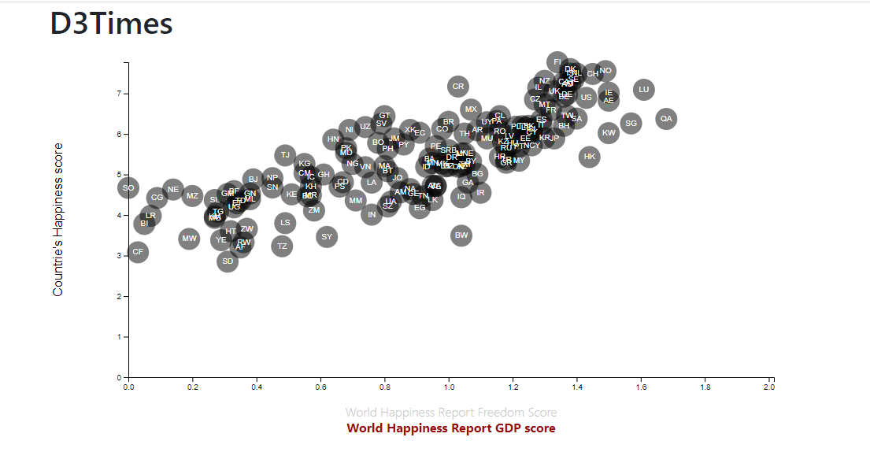
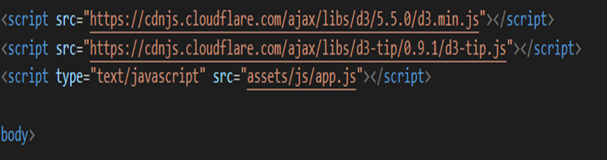
D3-Visualization
Add tooltip to circles and click event

Slide 10
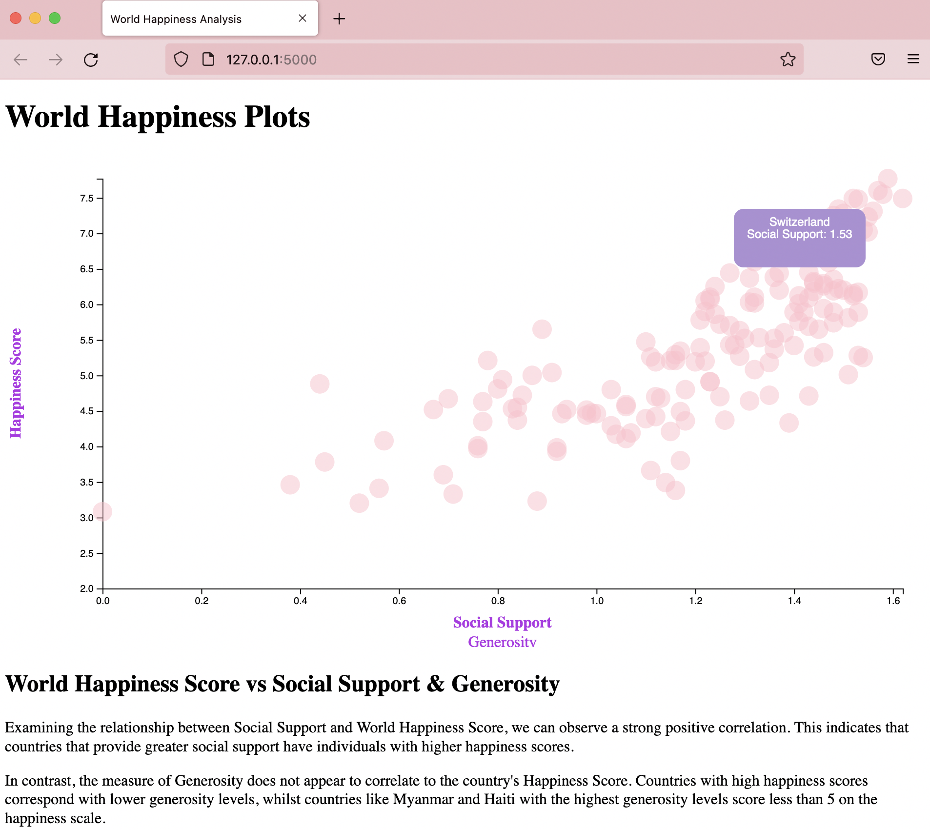
D3 Visualization
Flask-powered Interactive Dashboard visualization

Slide 11
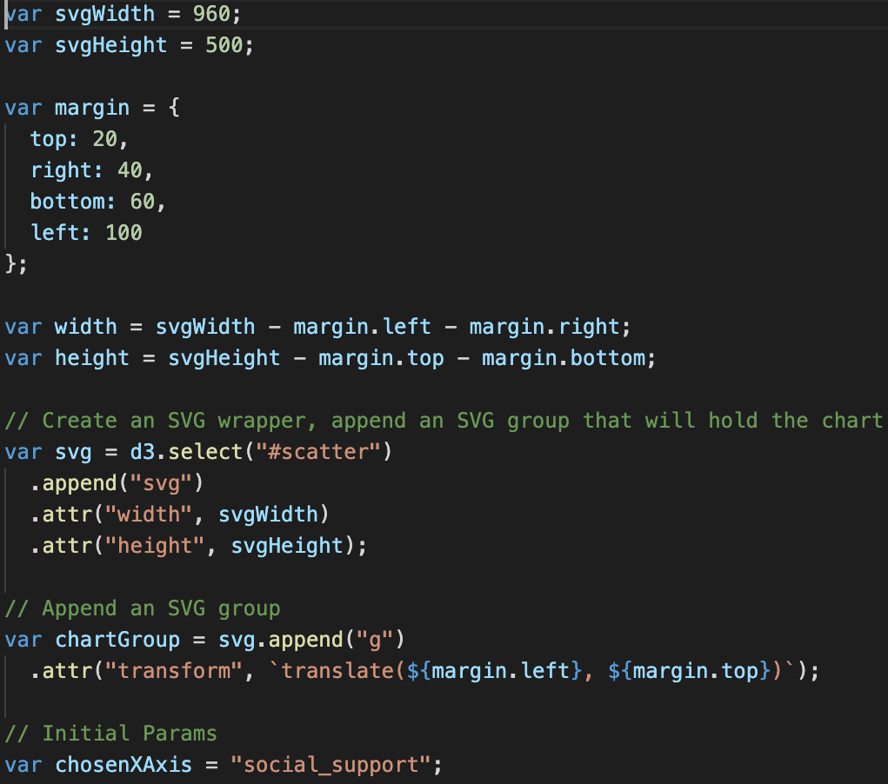
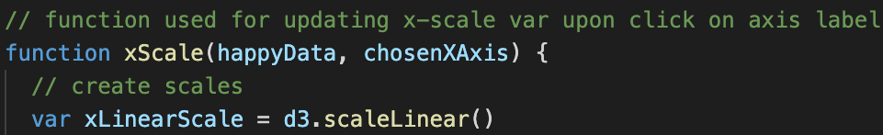
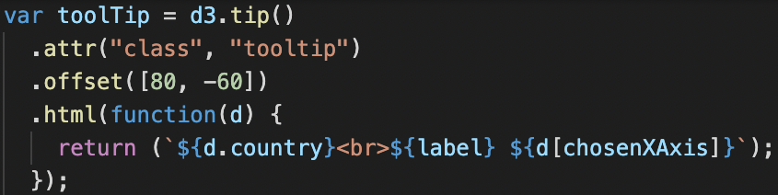
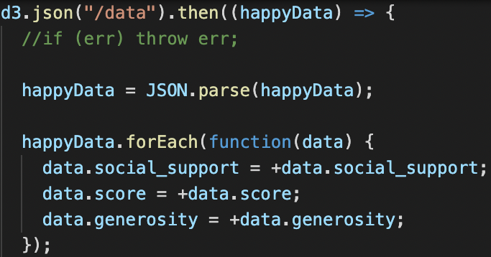
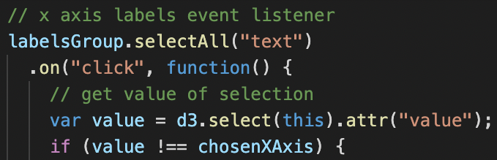
D3 Visualization
Country Happiness score vs. Social Support & Generosity score
Create Scales
Initialize ToolTip
Load Data
Event Listener

Slide 12
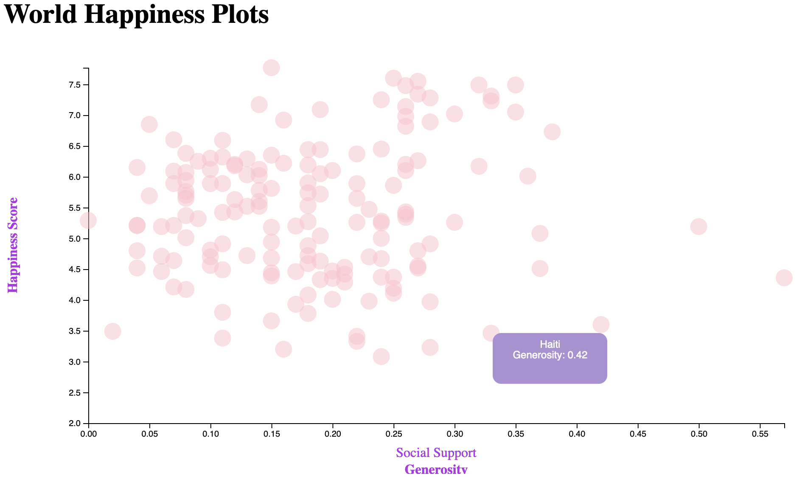
D3 Visualization
Social Support vs Happiness Score
Generosity vs Happiness Score

Slide 13
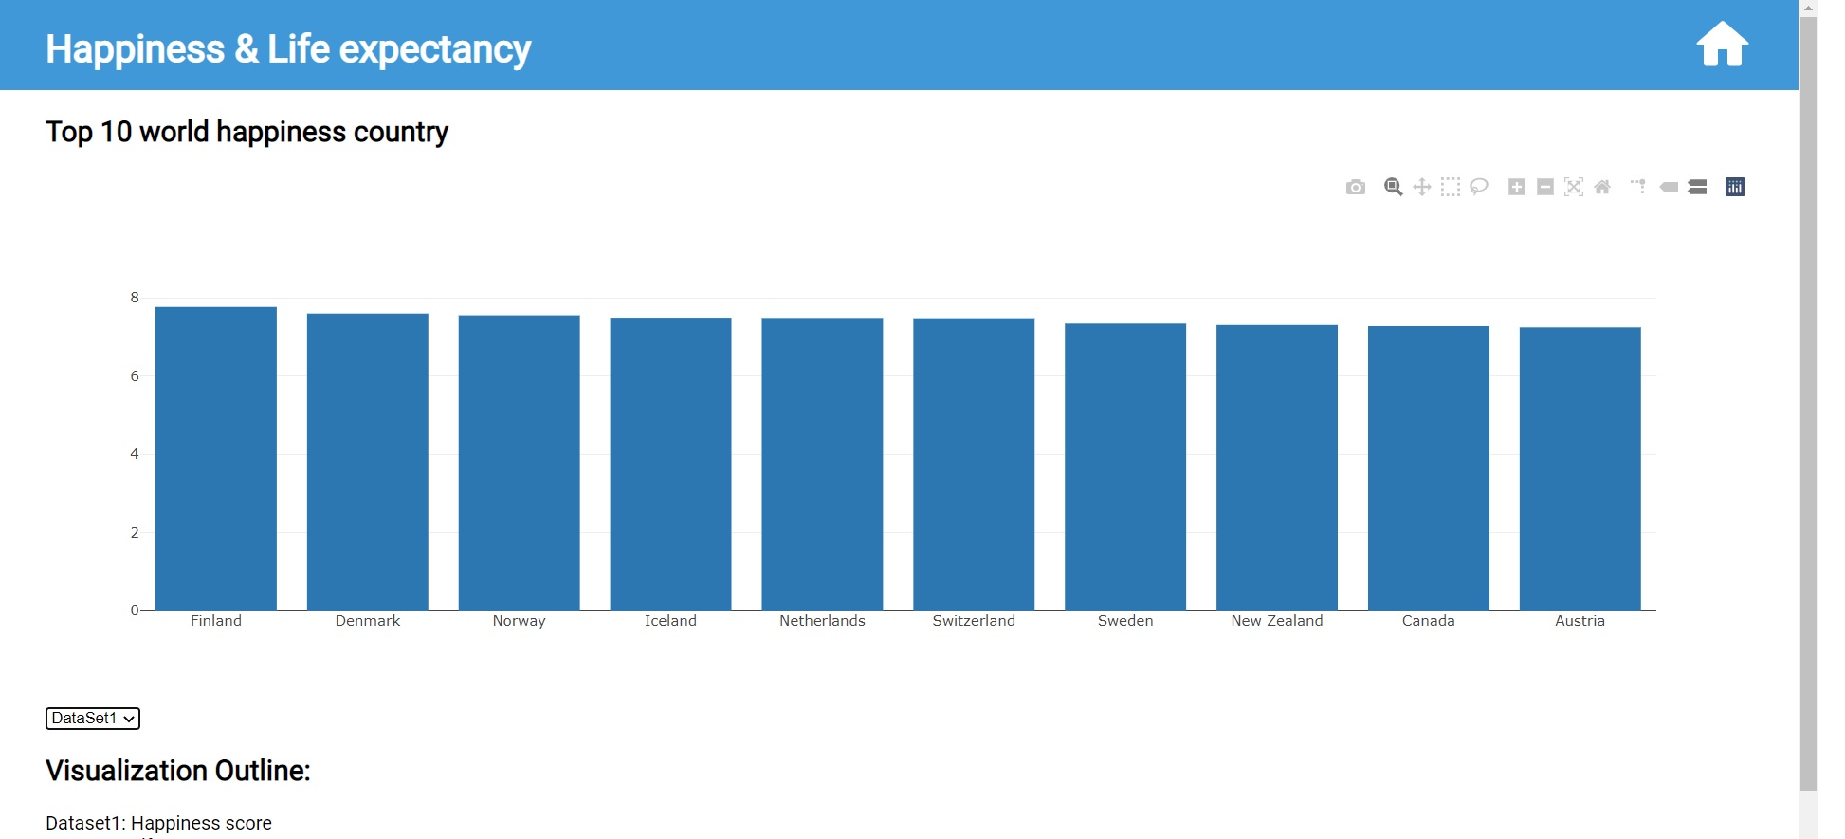
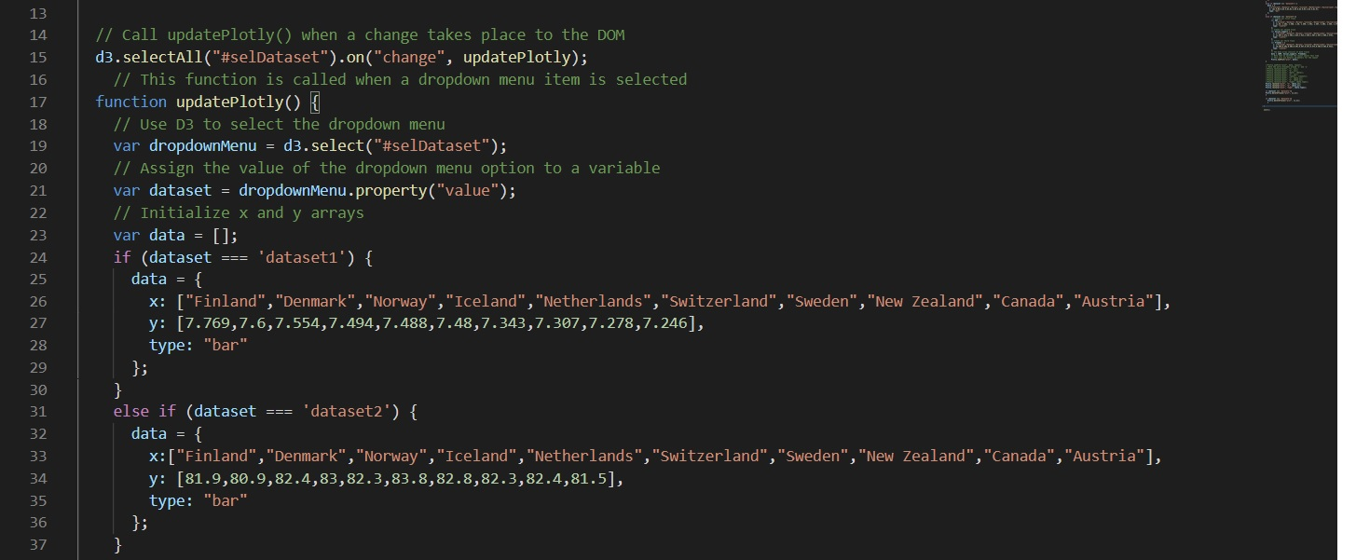
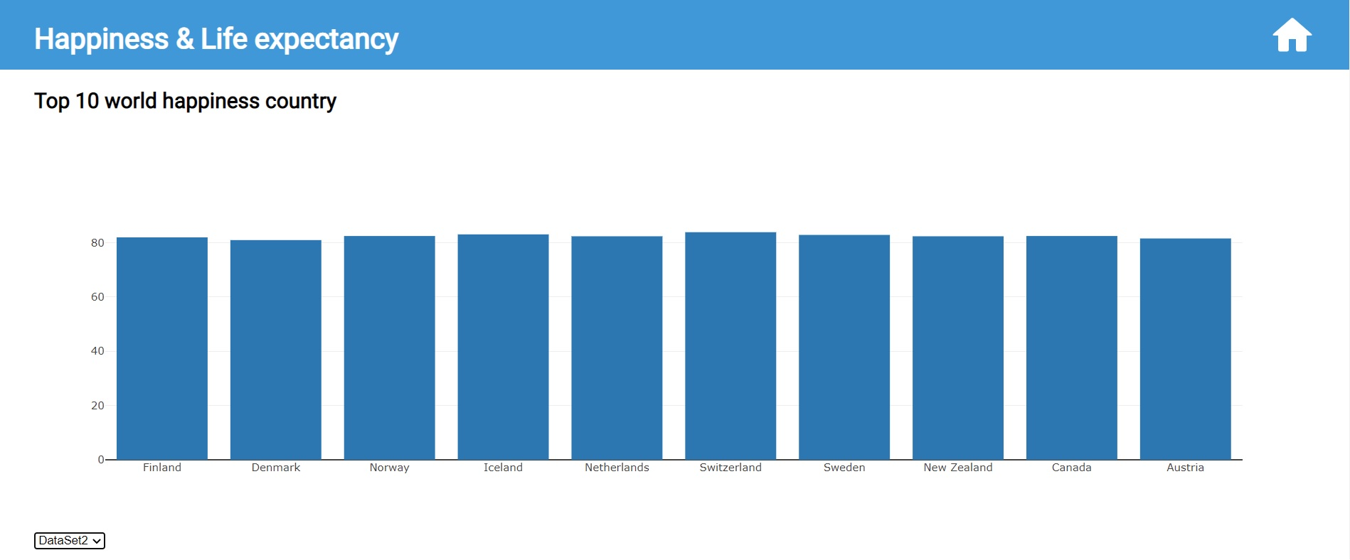
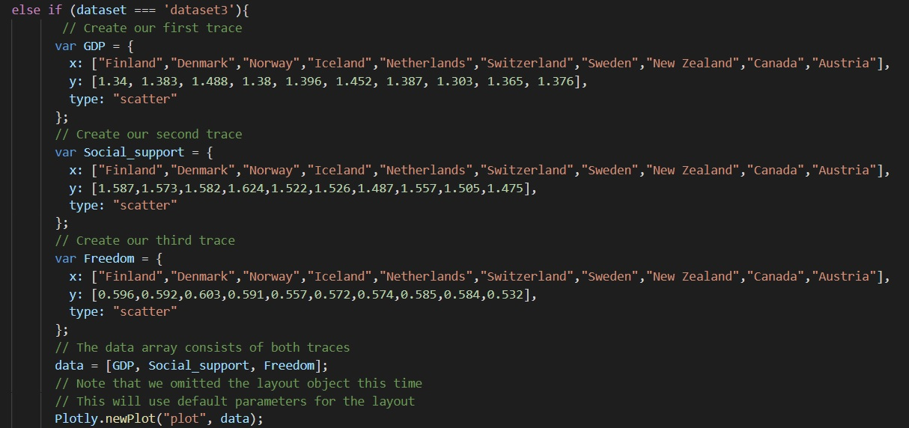
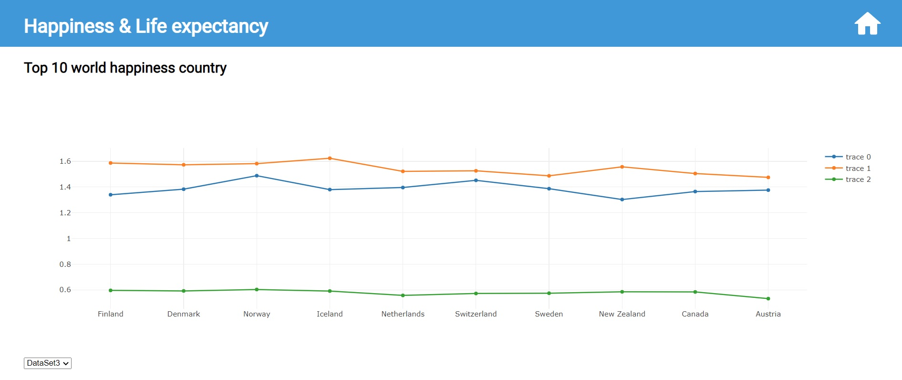
Plotly Visualization

Slide 14
Summary
Our report uses happiness report data for 156 countries of the year 2019.
Visualization starting from the data using SQL database using Flask to connect data to process and display data to all of the charts. As for the chart we use D3 and plotly to display the data. We use drop down and links to each chart for user driven interaction. All reports are rendered through the website using HTML/CSS, JavaScript.

